Slide 1



Creative Commons
Founded in 2001 by US academics, including Prof. Lawrence Lessig
Concerned that default copyright laws were restricting creativity in the digital environment
Aims to make creative material more freely usable through a suite of free, voluntary open access licences
AUSTRALIA
part of the Creative Commons international initiative
Notes:
Non-profit
Founded in 2001
These academics became concerned that the default copyright laws that applied in most countries were restricting creativity in the digital environment by preventing people from being able to access, remix and distribute copyright material online
For instances – most people know that it’s currently illegal under Australian law to record a television show to watch later – but did you also know that, in the absence of any licence, it’s also arguably illegal to print off a webpage for personal use, or to use a song in the background of a home video, or a student film
Even those people who want to make their material more freely available can’t do so without hiring lawyers
Taking inspiration from the open source movement, they decided to develop a set of licences that creators could use to make their material more freely available without giving up their copyright
They wanted to replace the standard “all rights reserved” model with a new, more flexible, “some rights reserved”

Slide 2
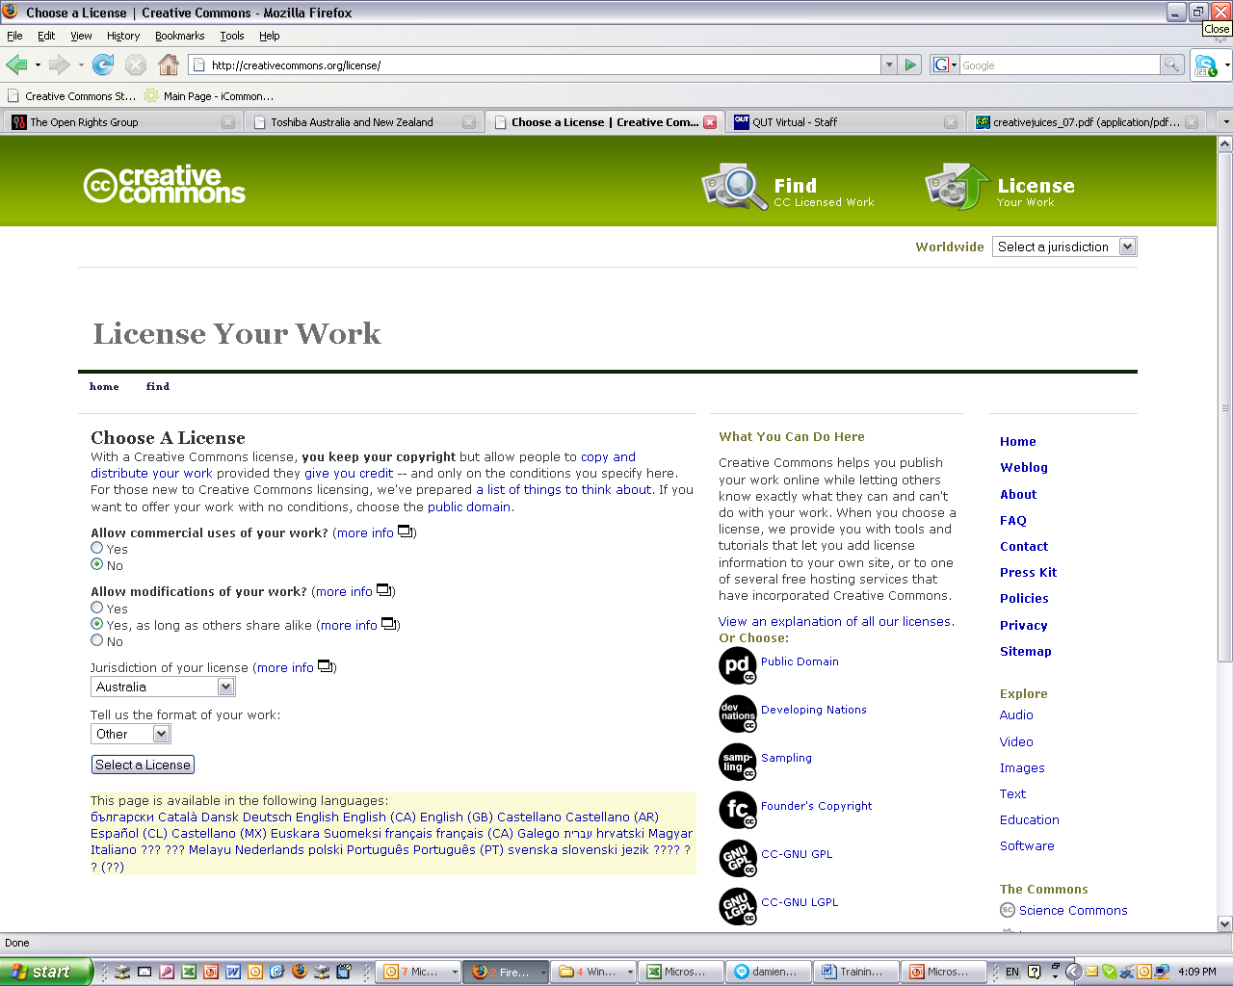
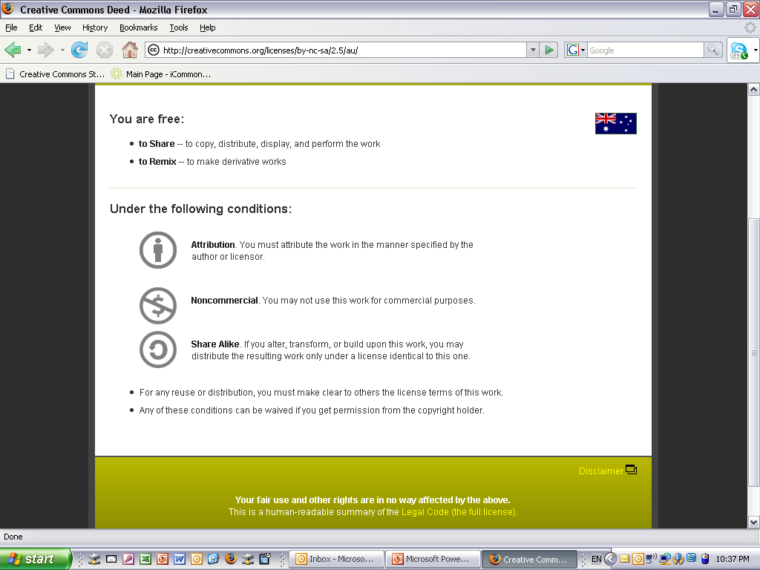
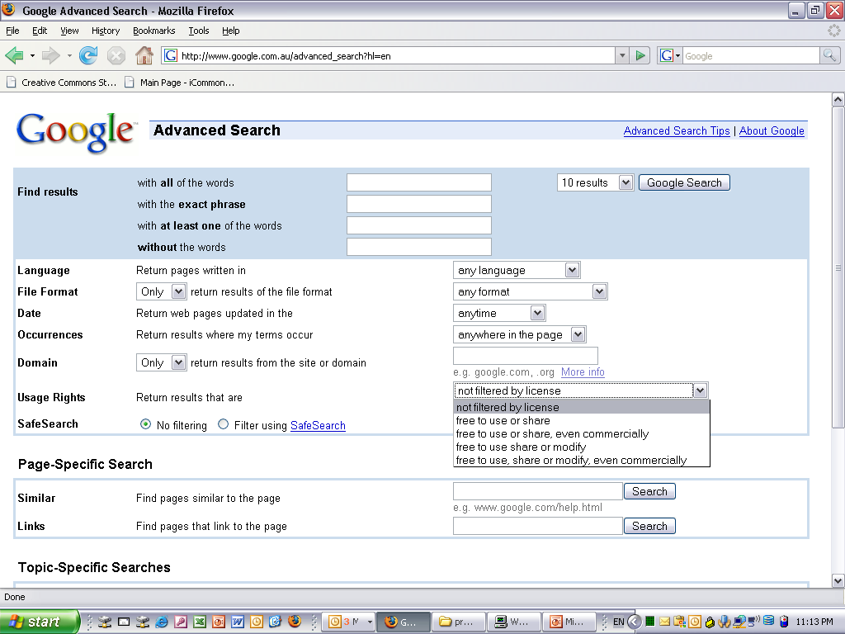
Licences
Flexible
mix and match 4 licence elements (attribution; non-commercial; no derivative works; sharealike) to make best licence for you
eg Attribution-Noncommercial-ShareAlike
Easy to use and understand
Tools help to choose appropriate licence eg licence generator, ccPublisher, Office plugin
Licence Deed gives ‘plain English’ terms of use
Built in metadata allows material to be searched for based on licence terms
AUSTRALIA
part of the Creative Commons international initiative
Notes:
The first CC licences were released in 2002
The central to each of the CC licences are the four licence elements – Attribution, noncommercial, no derivative and sharealike
These represent restrictions that copyright owners may want to put on how people can use their material.
As you can see, each of the elements has a symbol that can be used to ‘represent’ each of these elements
this makes the licences easier understand – in theory, once a person is familiar with the CC licences, they should be able to recognise what uses are allowed simply by looking at the symbols

Slide 3

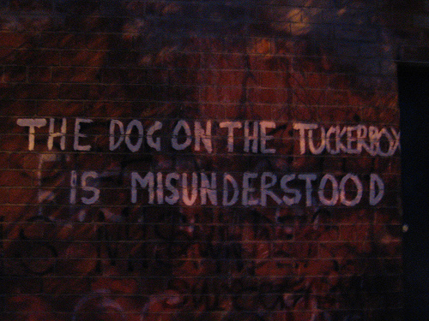
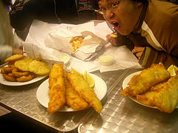
Click and Flick
National Library of Australia, working in collaboration with Flickr
Allows individuals to contribute to PictureAustralia Archive by uploading photos to designated Flickr groups
Originally encouraged use of Creative Commons licences – mandated for new ‘Ourtown’ group
13,000 contributions in first 12 months
:/ - http://www.flickr.com/photos/angelltsang/30211494/
Broken Simulacra -http://www.flickr.com/photos/broken_simulacra/91355505/
Antzpantz - http://www.flickr.com/photos/antzpantz/177067581/in/pool-69431001@N00/
AUSTRALIA
part of the Creative Commons international initiative
Notes:
A good example of this is the click and flick project
Launched in January this year, Click and Flick is a project of the NLA’s online pictorial gateway, PictureAustralia, in partnership with flickr
I’m sure most of you are familiar with PictureAustralia, but for those who aren’t, it’s an internet portal that allows users to search over 1.1 million images from 45 organisations across Australia and New Zealand simultaneously.
The click and flick initiative was launched in response to complaints that Picture Australia didn’t contain enough contemporary images
It lets individuals contribute their own images to PictureAustralia by uploading them onto dedicated flickr groups.
Most importantly, the National Library encourages people to licence their material as part of the collection under CC licences

